Slide 1

C# Fundamentals
Dara Oladapo

Slide 2

WindForce Corp
The super company that does a lot of awesome things

Slide 3

Lesson 1
Introducing C# and .NET
.NET
C#
Development Tools

Slide 4
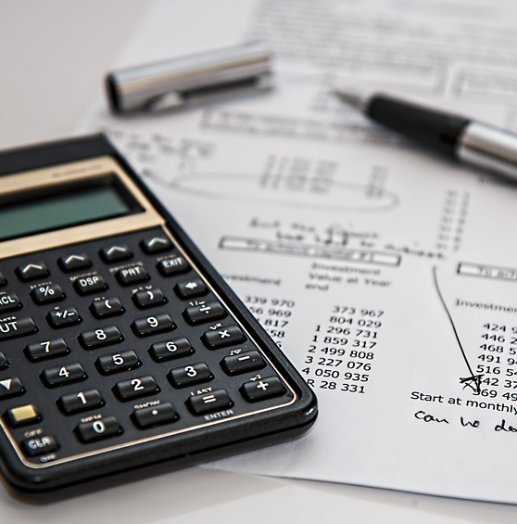
Lesson 2
Variables and Calculations

Slide 5
Data Types
Data Type | Meaning | Range
byte
sbyte
ushort
int
uint
long
ulong
float
double
decimal
char
string
bool
object

Slide 6

Lesson 3
Debugging

Slide 7

Lesson 4
Scope

Slide 8

Lesson 5
Strings

Slide 9

Lesson 6
Dates and Times

Slide 10
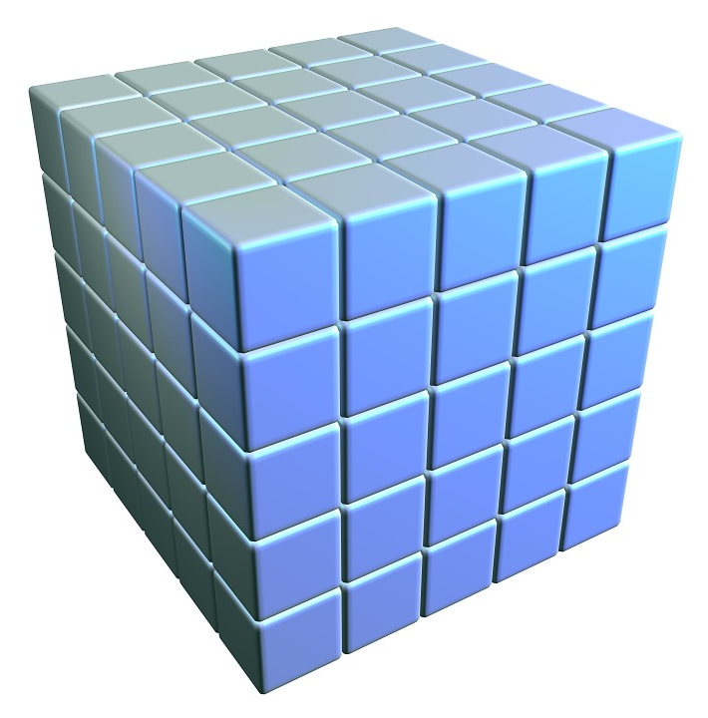
Lesson 7
Arrays and Collections

Slide 11

Lesson 8
Enumerations and Structures

Slide 12

Lesson 9
Making Choices

Slide 13

Lesson 10
Repeating Program Steps

Slide 14

Lesson 11
Reusing Code with Methods

Slide 15

Lesson 12
Handling Errors

Slide 16

Lesson 13
Preventing Bugs

Slide 17

Lesson 14
Defining Classes

Slide 18

Lesson 15
Initializing Objects

Slide 19

Lesson 16
Fine-Tuning Classes

Slide 20

Lesson 17
Overloading Operators

Slide 21

Lesson 18
Using Interfaces

Slide 22

Lesson 19
Making Generic Classes

Slide 23

Lesson 20
Windows Apps with XAML

Slide 24

Lesson 21
System.IO

Slide 25

Lesson 22
Programming Databases

Slide 26

Lesson 23
LINQ to Objects

Slide 27
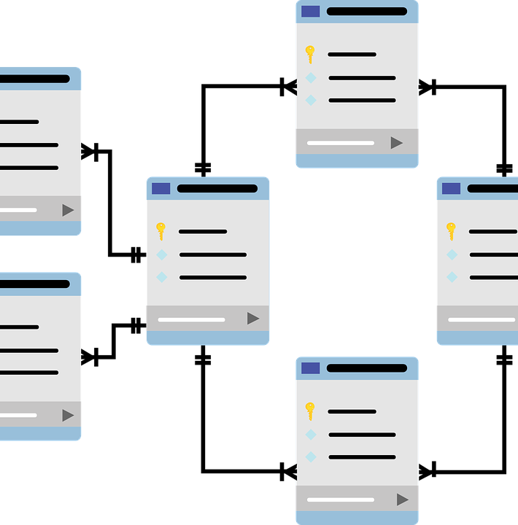
Lesson 24
LINQ to SQL

